Slide 1
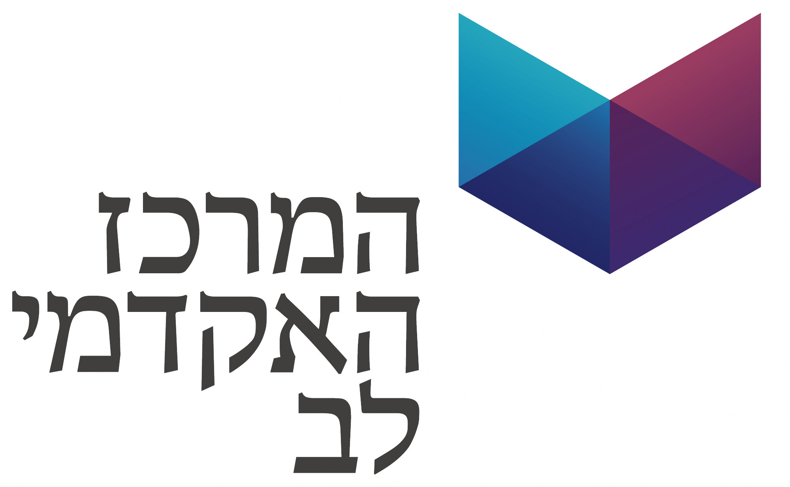
Information Retrieval Search Engine
Author - Ron Keinan
Moderator – Dr. Dror Mughaz
Department of Data Mining MSc
Lev Academic center

Slide 2
Table of contents
The project goal.
General methodology:
Method and Code flow.
Document Parsing.
Build models.
Query Parsing.
Similarity calculation.
Ignoring query words.
Conclusions and Future work .
Time for Questions.

Slide 3
The project goal
Build an Information retrieval system for searching query in text files.
The file system will be selected according to the language of the query – Hebrew or English.
The query is chosen by the user.
The system should retrieve a list of documents that answer the query.
The system should also retrieve an additional list that is relevant to the query and does not contain the words in the query.
Forbidden words include their inflections and not necessarily the specific words.
In each list, 30 documents must be retrieved in descending order of relevance.

Slide 4



General methodology:
Offline
Calc similarity of Query to documents:
BOW, Jaccard, BM25, Doc2Vec
File System
(docs)
-Sum similarities
-Sort documents descending
-Preprocess
-Tokenize
-Lemmatize
Train Doc2Vec model and infer vectors
Build BOW model and infer vectors
Query
user
-Preprocess
-Tokenize
-Lemmatize
-Sum similarities
-Sort documents descending
-Remove docs with forbidden words
Create synonym query

Slide 5
Document Parsing
Calc similarity of Query to documents:
BOW, Jaccard, BM25, Doc2Vec
File System
(docs)
-Sum similarities
-Sort documents descending
-Preprocess
-Tokenize
-Lemmatize
Train Doc2Vec model and infer vectors
Build BOW model and infer vectors
Query
user
-Preprocess
-Tokenize
-Lemmatize
-Sum similarities
-Sort documents descending
-Remove docs with forbidden words
Create synonym query

Slide 6
Document Parsing
Process text:
Remove punctuation.
Remove non-language characters.
Tokenize text:
Split to tokens.
Remove stop words – usually don’t add information (common).
Lemmatize text:
Grouping together of different forms of the same word.
English with NLTK WordNetLemmatizer.
Hebrew with YAP.

Slide 7
Yap – yet another parser
Hebrew parser created by ONLP lab in Bar Ilan University led by Prof. Tsarfaty.
Written in GO.
Based on MILA vocabulary.
Trained on 6000 sentences from “Ha’Aretz” newspaper
Receives sentence as set of tokens.
3 simple installation steps. Available locally with cmd, with HTTP requests or online for non programmers.
Output – Lemmas, Morphological segmentation and features, Pos, NER, lattices and more
Notes:
תוכנית הביאור – בהתבסס על השיטה – מוציאים 5 ניתוחים מהטקסט:
Morphological segmentation – הניתוח הבסיסי ביותר בעברית. חלוקה של מילה לסגמנטים שלה, נקראות מורפמות. למשל המילה בבית – בית+ה'+ב' = in the house.
Part of speech – לכל מורפמה מצמידים תיוג POS, שהוא סיווג תפקידה במשפט – פועל, שם, תיאור זמן ועוד.
Morphological features – תכונות נלוות לתכונת ה-POS: כמות (יחיד/רבים/דואלי), מגדר(זכר/נקבה/דואלי), גוף (ראשון/שני/שלישי/כולם), וזמן(עבר, הווה, עתיד, אינסופי. הווה מתויג כבינוני)
Lemmas – מצמידים לכל סגמנט את הייצוג הקנוני של המשמעות שלו. לשמות עצם ותואר נבחרה צורת זכר יחיד. לפעלים גוף שלישי זכר יחיד בזמן עבר.
Dependency trees – מציג תלויות בעזרת עץ בין הסגמנטים השונים במשפט. למשל נושא –נשוא וכו'.
lattices – עבור כל סגמנט במשפט – כל הניתוחים האפשריים עבור כל סגמנט במשפט.

Slide 8
Build models - BOW
Calc similarity of Query to documents:
BOW, Jaccard, BM25, Doc2Vec
File System
(docs)
-Sum similarities
-Sort documents descending
-Preprocess
-Tokenize
-Lemmatize
Train Doc2Vec model and infer vectors
Build BOW model and infer vectors
Query
user
-Preprocess
-Tokenize
-Lemmatize
-Sum similarities
-Sort documents descending
-Remove docs with forbidden words
Create synonym query

Slide 9
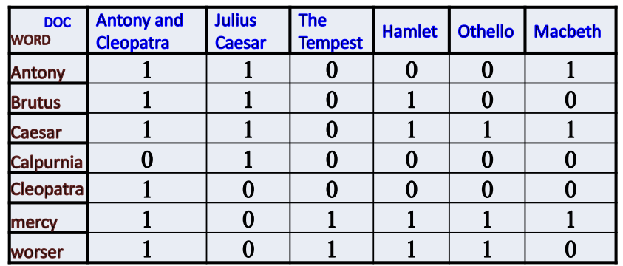
Build models - BOW
A text (such as a sentence or a document) is represented as the bag (multiset) of its words, disregarding grammar and even word order but keeping multiplicity.
The (frequency of) occurrence of each word is used as a feature.
Create vocabulary from all the lemmatized texts, infer vector for each document and save the Vocab model..
Simple kind of VSM (Vector space model).

Slide 10
Build models – Doc2Vec
Calc similarity of Query to documents:
BOW, Jaccard, BM25, Doc2Vec
File System
(docs)
-Sum similarities
-Sort documents descending
-Preprocess
-Tokenize
-Lemmatize
Train Doc2Vec model and infer vectors
Build BOW model and infer vectors
Query
user
-Preprocess
-Tokenize
-Lemmatize
-Sum similarities
-Sort documents descending
-Remove docs with forbidden words
Create synonym query

Slide 11
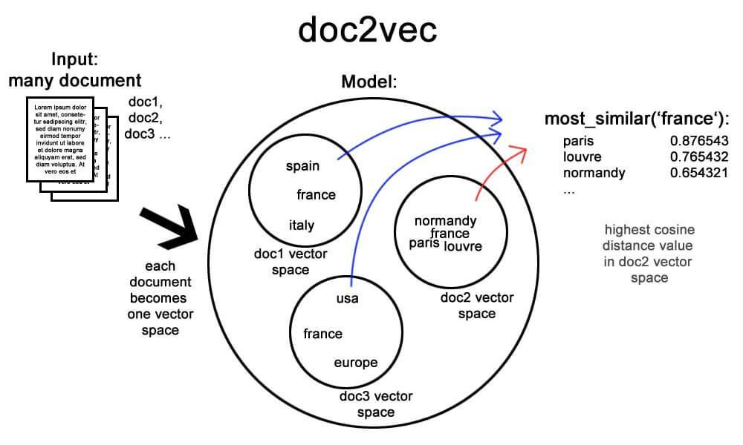
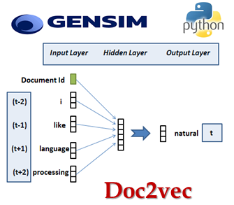
Build models – Doc2Vec
An NLP tool for representing documents as a vector.
A generalizing of the word2vec method.
Train the model on all the lemmatized texts, infer vector for each document and save the model.
Another kind of VSM.

Slide 12
File System Efficiency
Models are saved to local storage:
Processed file system.
Doc2vec model.
Bow Vocabulary.
User is given the option to use the saved File system or to update it.
Every night full update of the system.

Slide 13
Query Parsing
Calc similarity of Query to documents:
BOW, Jaccard, BM25, Doc2Vec
File System
(docs)
-Sum similarities
-Sort documents descending
-Preprocess
-Tokenize
-Lemmatize
Train Doc2Vec model and infer vectors
Build BOW model and infer vectors
Query
user
-Preprocess
-Tokenize
-Lemmatize
-Sum similarities
-Sort documents descending
-Remove docs with forbidden words
Create synonym query

Slide 14
Query Parsing
Get language –
calculate percent of alphabetic characters, above limit is the language.
Limit of 60% by Trial and error.
No tool for Hebrew language recognition..?
Turn to document – process, tokenize, lemmatize.
Infer vector from BOW vocabulary.
Infer vector from trained dec2vec model

Slide 15
Similarity calculation
Calc similarity of Query to documents:
BOW, Jaccard, BM25, Doc2Vec
File System
(docs)
-Sum similarities
-Sort documents descending
-Preprocess
-Tokenize
-Lemmatize
Train Doc2Vec model and infer vectors
Build BOW model and infer vectors
Query
user
-Preprocess
-Tokenize
-Lemmatize
-Sum similarities
-Sort documents descending
-Remove docs with forbidden words
Create synonym query

Slide 16
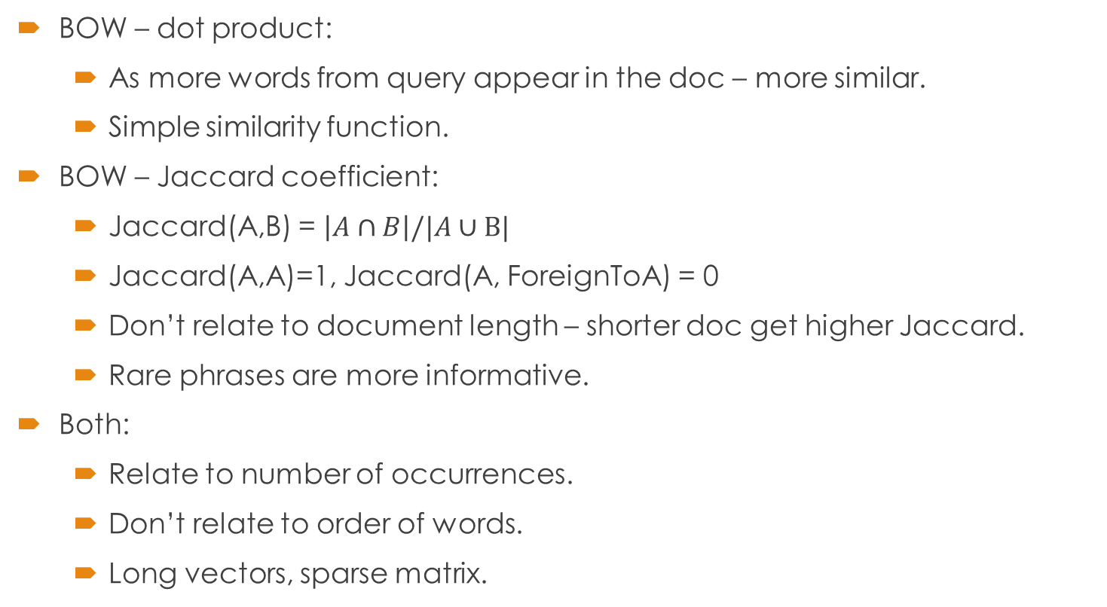
Similarity calculation
BOW – dot product:
As more words from query appear in the doc – more similar.
Simple similarity function.
BOW – Jaccard coefficient:
Jaccard(A,B) = $\left|A∩B\right|/|A∪B|$
Jaccard(A,A)=1, Jaccard(A, ForeignToA) = 0
Don’t relate to document length – shorter doc get higher Jaccard.
Rare phrases are more informative.
Both:
Relate to number of occurrences.
Don’t relate to order of words.
Long vectors, sparse matrix.

Slide 17
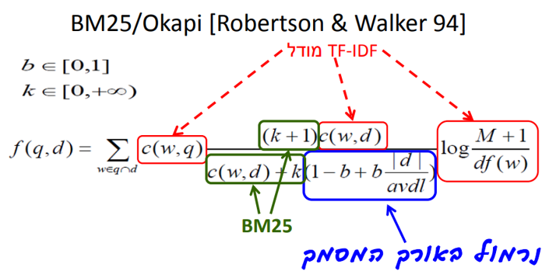
Similarity calculation
TF-IDF – BM25:
TF = term frequency, number of occurrences of query word in doc.
IDF = Inverse Document Frequency – occurrences of word in all documents.
TF/IDF – occurrence of query word in doc makes it relevant, and even more if the word is rare (therefore more informative).
BM25 – popular transformation for TF to lower its influence. Has upper and lower limit so better than logarithm.
Okapi – normalize by average doc length to “punish” long documents that can fit many queries. (long doc also has more content so don’t punish too much).
Notes:
IDF זה מספר המסמכים הכללי חלקי מספר המסמכים עם המילה הספציפית. ככל שמופיעה ביותר מסמכים היא מקבלת פחות משקל. בד"כ עושים log של מונה מספר המסמכים ועוד 1 חלקי מספר המסמכים עם המילה.
פונקציית הדירוג היא מכפלה של Tf*Idf.
עושים טרנספורמציה על Tf כי ככל שמילה מופיעה יותר פעמים זה עוזר אבל פחות, לכן אפשר log, ואפשר BM25 שזה טרנספורמציה עם קבוע חיובי k שתוחמת את רמת ההשפעה ל-k. בד"כ בוחרים בין 1.5 ל-2. זו טרנספורמציה תת לינארית, מאפשרת תשואה הולכת ופוחתת, ככה שמושג אחד לא ישתלט על האחרים.
מוסיפים גם נרמול באורך המסמך – כי מסמך ארוך יותר יכיל יותר מילים מהשאילתא. מכניסים גורם avdl שזה אורך מסמך ממוצע, ואז מסמך ארוך יותר יוענש בפחות השפעה ל-tf:

Slide 18
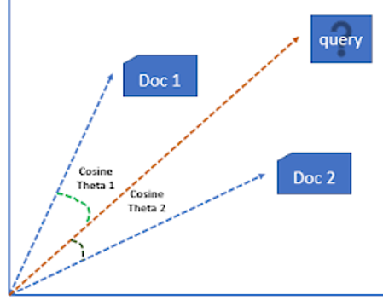
Similarity calculation
Doc2Vec – cosine Similarity:
measures the similarity between two vectors of an inner product space.
Measured by the cosine of the angle between two vectors.
Represents distance between vectors in the VSM.
General:
All similarities normalized 0-1 by dividing in Max.
Reverse doc2vec similarity for uniformity (higher is closer).
Sort documents by descending similarities and print.
User can choose by which similarity to rank.

Slide 19
Ignoring query words
Calc similarity of Query to documents:
BOW, Jaccard, BM25, Doc2Vec
File System
(docs)
-Sum similarities
-Sort documents descending
-Preprocess
-Tokenize
-Lemmatize
Train Doc2Vec model and infer vectors
Build BOW model and infer vectors
Query
user
-Preprocess
-Tokenize
-Lemmatize
-Sum similarities
-Sort documents descending
-Remove docs with forbidden words
Create synonym query

Slide 20
Ignoring query words
Create new query:
Every word turns to it’s synonym.
English – based on NLTK WordNet.
Hebrew – no professional tool. (try with translate to English and the NLTK – bad results).
Calculate similarities to new query.
Main contributor is doc2vec similarity – not depended in the words.
Remove from document list all docs that contain query lemmas.
Continue as usual ranking.

Slide 21
Demonstration

Slide 22
Conclusions
English NLP tools are much more common and accurate.
Hebrew NLP is complicated – Rich Morphological structure, Prepositions, Diacritical marks, Flexible word order …
BOW is very slow for calculating.
Doc2vec, TF-IDF are more accurate implementations of VSM for document similarity ranking.
Preprocessing is critic in search engines.

Slide 23
Future work
Implement more ranking methods – query likelihood etc.
Improve IR engine by user feedback.
Train Hebrew synonym model based on word2vec.
Use stronger serves and/or multiprocessing for quicker parsing.
Bigger file system will improve the models accuracy(simulate language)
GUI.
Specific update of files.

Slide 24
Thank you!
Any questions?

